Slide 1
A Voucher can be submitted every 30 days for interim settlements, but once a voucher is settled, Travel Advances can’t be issued.
Recommend dependents request Advances every 30 days and submit a voucher at end of Safe Haven period.

Slide 2

Travel Processing Center
Dependent Evacuation Travel Settlement Request
20 March 2026
CDR John Allen
Officer In Charge

Slide 3
Required Documents for Submission
Copy of Evacuation Orders
DD 1351-2
Zero balance lodging receipts
Banking Information – NPPSC 7000/1 EFT Form
Any additional pertinent information or receipts
Notes:
Dependents are authorized to sign as “Service Member” for all required forms
MNCC Rep. will sign as “CPPA” “Command” and “AO” on forms.
A Voucher can be submitted every 30 days for interim settlements, but once a voucher is settled, Travel Advances can’t be issued. Recommend dependents request Advances every 30 days and submit a voucher at end of Safe Haven period.

Slide 4
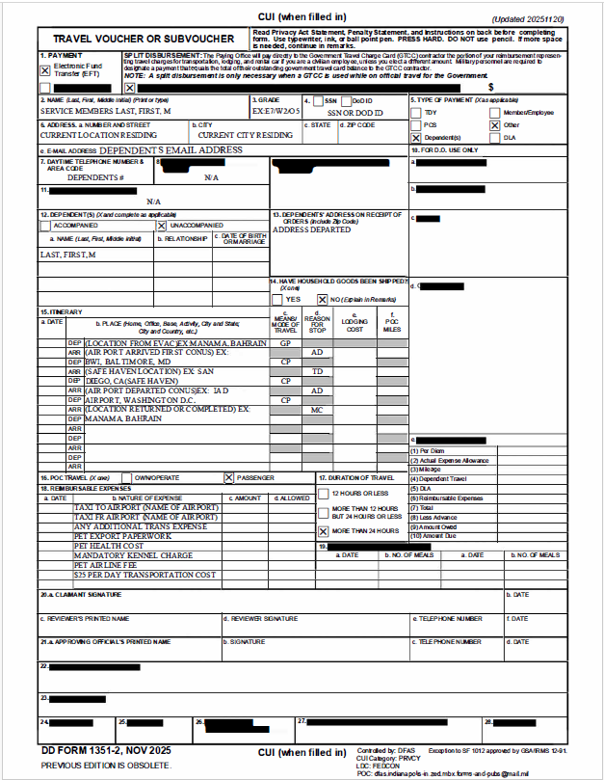
DD 1351-2 TRAVEL VOUCHER OR SUBVOUCHER
Block 1: Select “EFT”
Block 2: Sponsor Name
Block 3: Sponsor Paygrade (E6, O2, W3, etc.)
Block 4: Either Sponsor SSN or DoD ID
Block 5: Select “Dependent” and “Other”
Block 6: Current Address (Safe Haven Location)
Block 6e: Dependent Email Address
Block 7: Dependent Phone Number
Block 8: Enter “NA”
Block 9: Leave Blank
Block 10: Leave Blank
Block 11: Enter “NA”
Block 12: List all Evacuated Dependents
Block 13: OCONUS Address Dependents evacuated
Block 14: Select “No”
Note: Sponsor information on Dependent ID

Slide 5
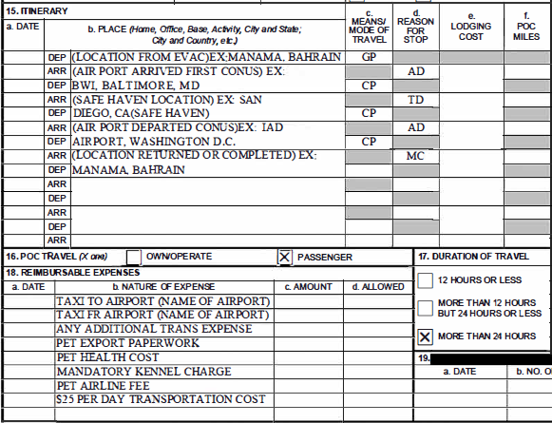
DD 1351-2 TRAVEL VOUCHER OR SUBVOUCHER
Block 15a: Date each action occurred
Block 15b: Location of Departure and Arrival for each leg of travel.
Block 15c: GP = Gov. Plane, CP = Commercial Plane, PA = Private Auto, CA = Commercial Auto (Taxi)
Block 15d: AD = Authorized Delay, TD = Temporary Duty (Safe Haven), MC = Mission Complete
Block 15e: Enter Total Lodging Cost at each leg
Block 15f: Leave Blank
Block 16: “Passenger” unless dependent used their own car.
Block 17: Select “More than 24 Hours”
Block 18a: date or date range expense occurred
Block 18c: Cost of Expense
Block 18d: Leave Blank
Block 19: Leave Blank

Slide 6
DD 1351-2 TRAVEL VOUCHER OR SUBVOUCHER
Block 20a: Dependent Signature
Block 20b: Date Dependent Signs
Block 20c -28: Will be filled out after submission by MNCC Rep.
Note:
Dependents are authorized to sign for “Claimant Signature”
MNCC Rep. will sign for “Reviewer” & “Approving Official”

Slide 7
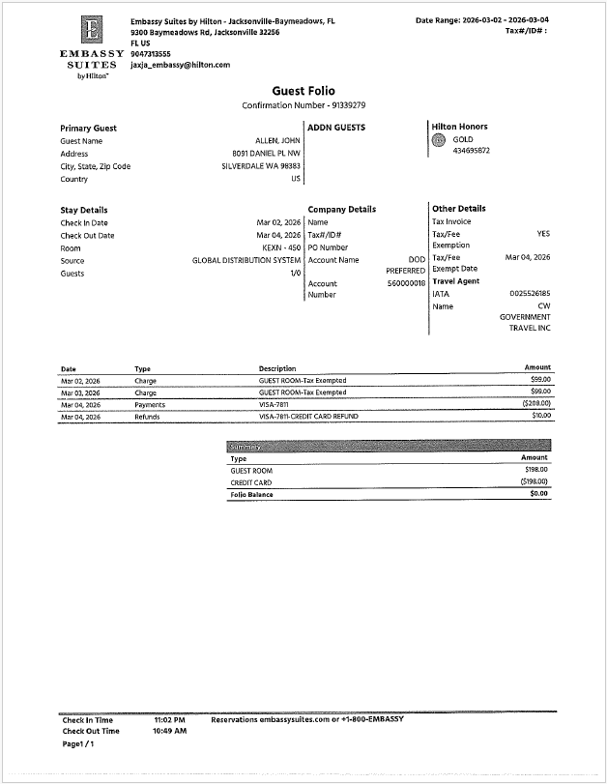
Zero Balance Lodging Receipt
Hotel (Conventional)
Rates must be Itemized
Must show a “$0.00” balance
Vacation Rental (Long Term)
Total Cost of Long Term rental cannot exceed the aggregate daily rate for Conventional Lodging. (JTR 020303 para G)
Itemized receipts are required per JTR para, 020303 if evacuees are using lodging with vacation rentals such as Airbnb, VRBO, etc.
Receipt is NOT required to show daily itemization (Rate, Taxes, Fees, etc.)

Slide 8
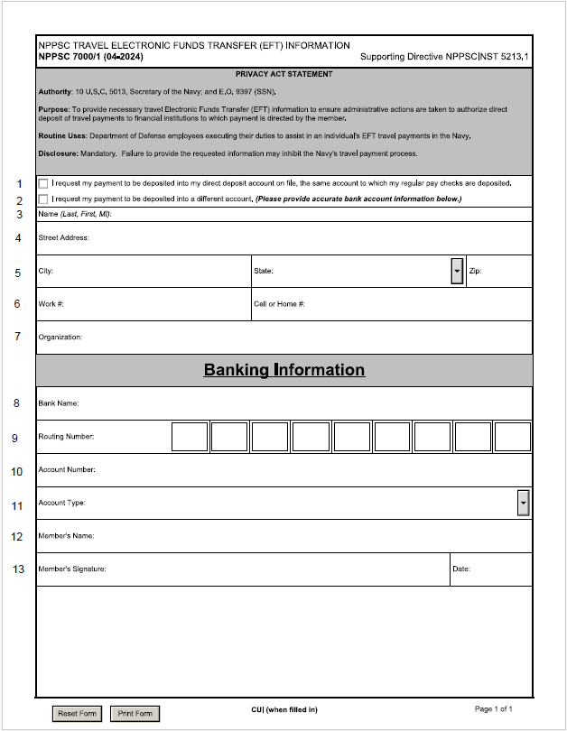
NPPSC 7000/1: Electronic Funds Transfer (EFT) Information
Line 1: Check if you desire funds to be deposited into Service Member’s Direct Deposit Account
Line 2: Check if you desire funds to be deposited into a different account
- Lines 3-13 only if Line 2 is checked -
Line 3: Dependent Name
Line 4: Safe Have (Current) Address
Line 5: Safe Have Address Continued
Line 6: Dependent Phone Number
Line 7: Leave Blank
Line 8: Name of Bank for new deposit account
Line 9: Routing number for new deposit account
Line 10: New deposit account number
Line 11: Checking or Savings
Line 12: Account Holder (Dependent) Name
Line 13: Account Holder Signature and Date

Slide 9
How To Submit Request
Individual Requests Directly from Dependents, email to:
AskMNCC@us.navy.mil
Group Requests from Commands, email to:
hrscoperationsleadership@us.navy.mil
Attn: Mary K. Willis, Acting Chief Operations Officer

Slide 10
Questions

